Slide 1

Smile Foundation
“
“Build a Bright Future for Poor Children”

Slide 2
Presented By…
Presented By…
Prajapati Krish R.(2021095900023461)
Patel Karan J. (2021095900023213)
Kadiya Smit V.(2021095900024947)
Patel Shrey K. (2021095900024112)
Patel Vraj K. (2021095900024901)

Slide 3
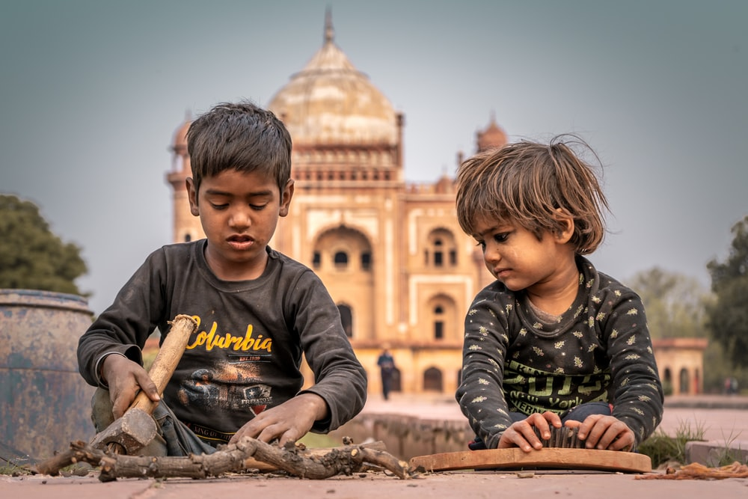
Intro
What is the NGO?
What we Do?
What is the Meaning of our Project?
Overview
Outline

Slide 4
Introduction
Smile Foundation is an innovative learning organization created to improve the quality of education and healthcare in India. Established in 2023 to provide education to children in the Gujrat.
How do you want to help children today?
→ Your smallest contribution makes a big difference to children’s lives. We count on the generosity of people like you to be able to create real change for India’s children!

Slide 5
What is the Non-Governmental Organisation ?
A non-governmental organization (NGO) is a group that functions independently of any government.
sometimes called civil society organizations, are established on community, national, and international levels to serve a social or political goal such as a humanitarian cause or the protection of the environment.
For example, NGOs might focus on activities in areas involving health or health emergencies, education, infrastructure, advocacy of minority rights, support of the poor, and the reduction of crime.

Slide 6
What We Do ?
Education
Ensuring that children go to school and complete their education.
Health & Nutrition
Increasing access to proper nutrition and quality healthcare.
Safety & Protection
Addressing issues like child labour, child marraige, trafficking and abuse.
Child Participation
Creating an environment where children’s voices are heard and considered

Slide 7
What is the meaning of our Project?
The NGO believes that education is both the means as well as the end to a better life: the means because it empowers an individual to earn his/her livelihood and the end because it increases one's awareness on a range of issues – from healthcare to appropriate social behavior to understanding one's rights – and in the process help him/her evolve as a better citizen.
Smile Foundation facilitates medical treatment for critically ill underprivileged children suffering from a heart disorder. They want to continue to Save Little Hearts for many more children between 0-18 years from families with a monthly income of less than Rs. 10,000 per month.

Slide 8
They aim to give each beating heart in need a chance to live. They hope to identify children who are in need of urgent medical attention and work directly with families, doctors and gaurdians.

Slide 9
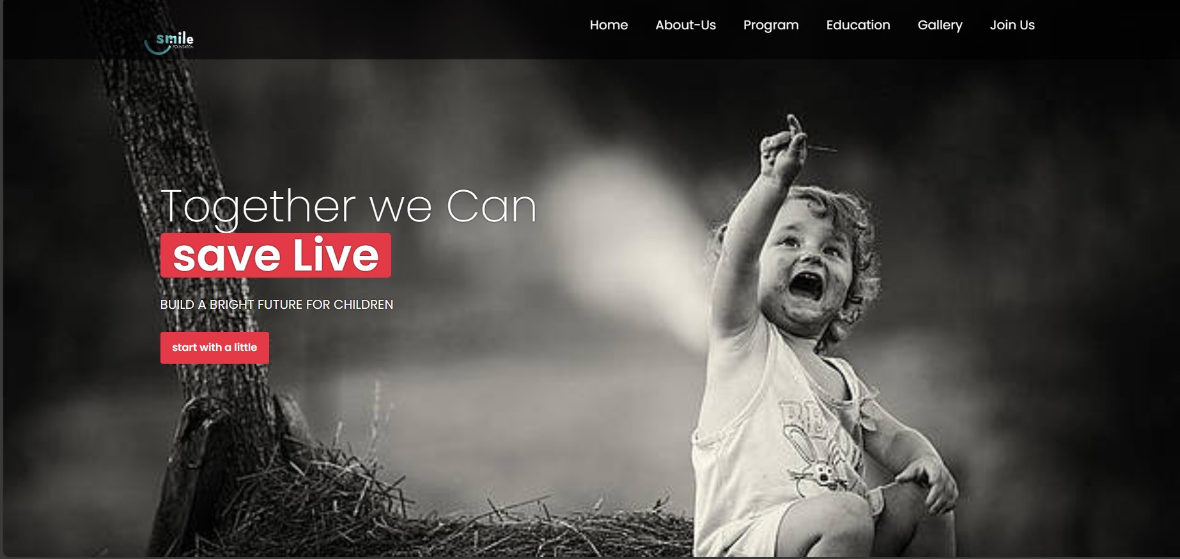
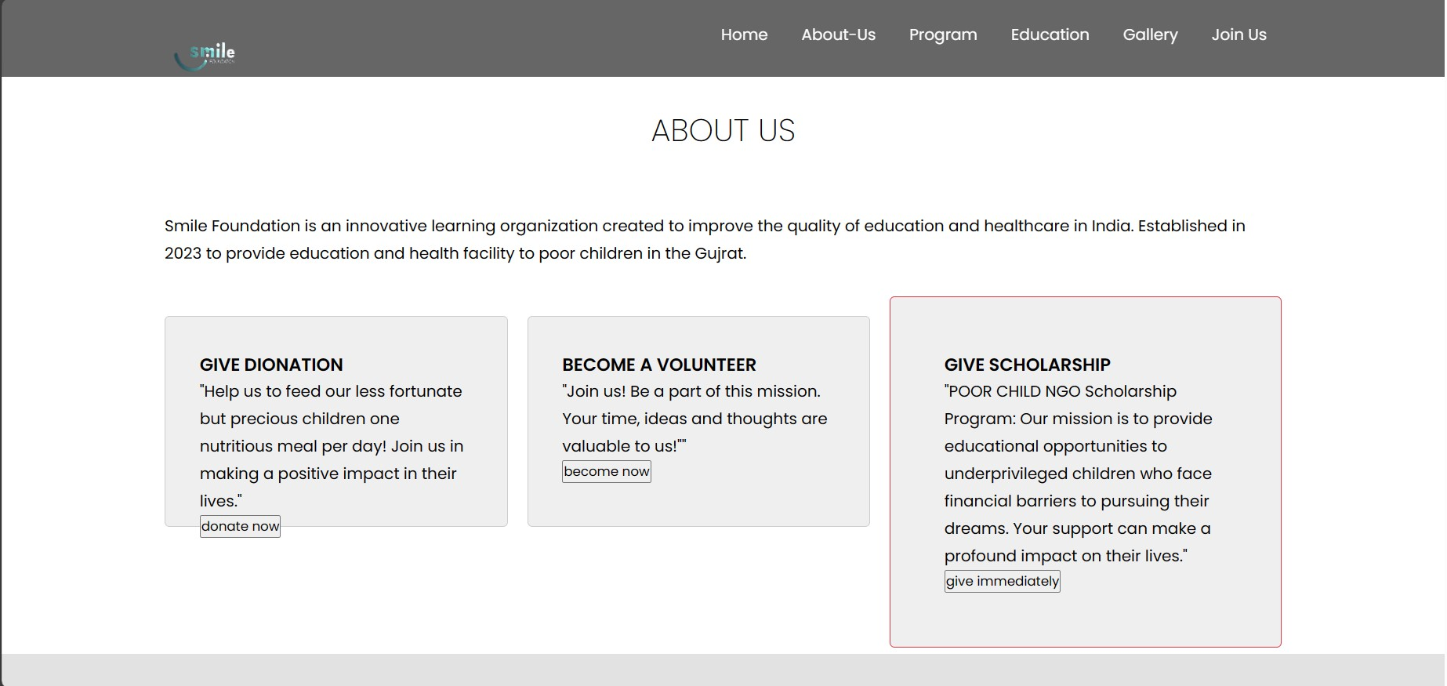
overview

Slide 10
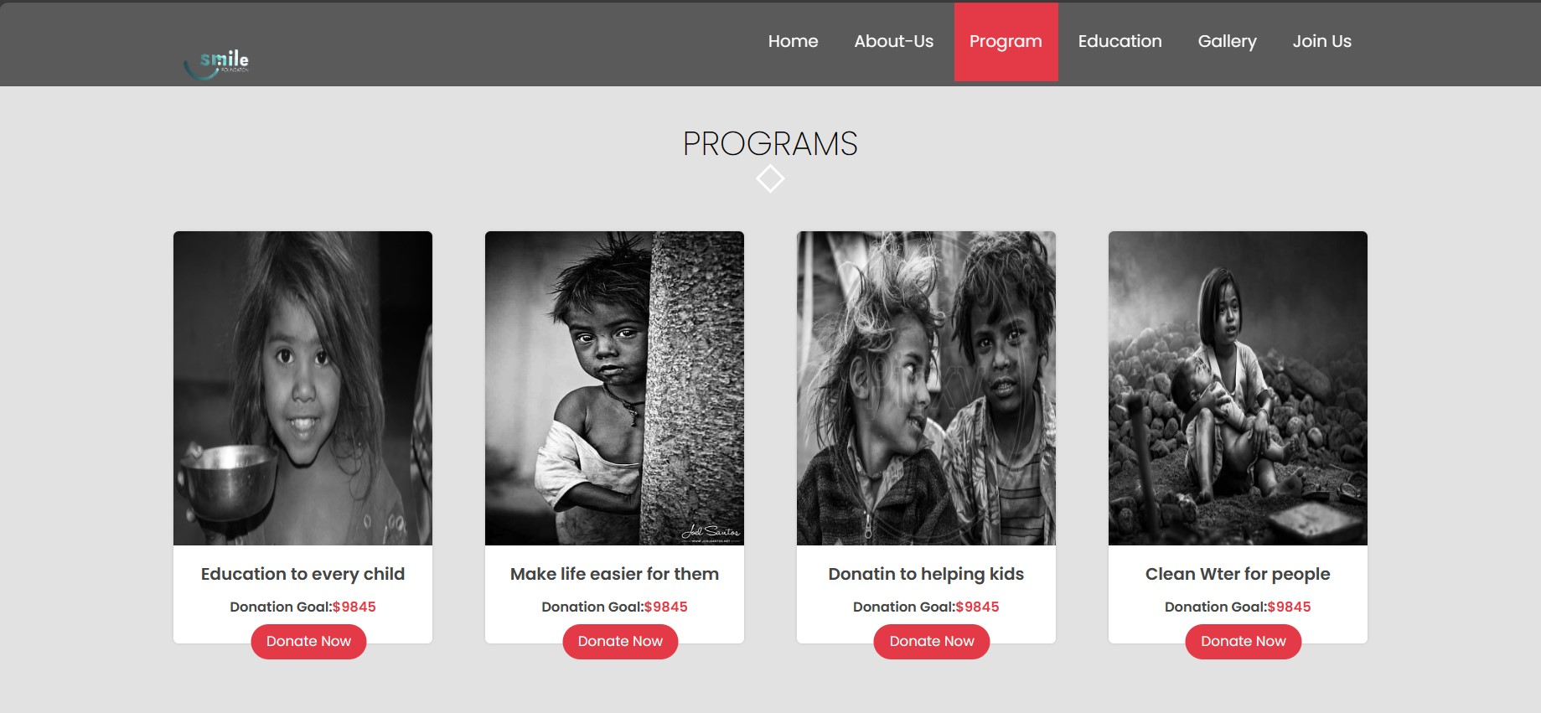
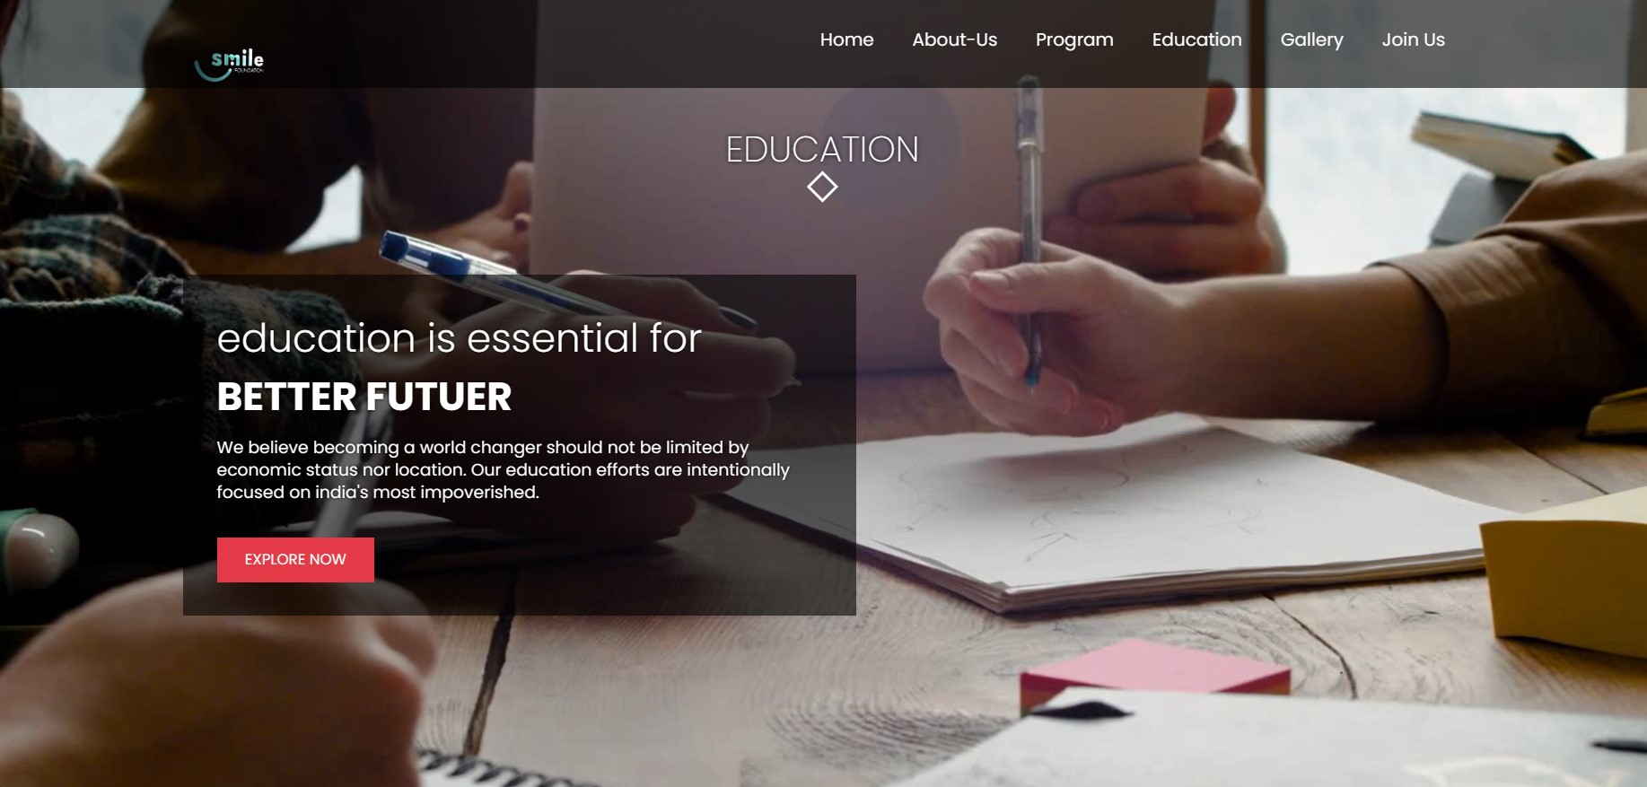

Slide 11
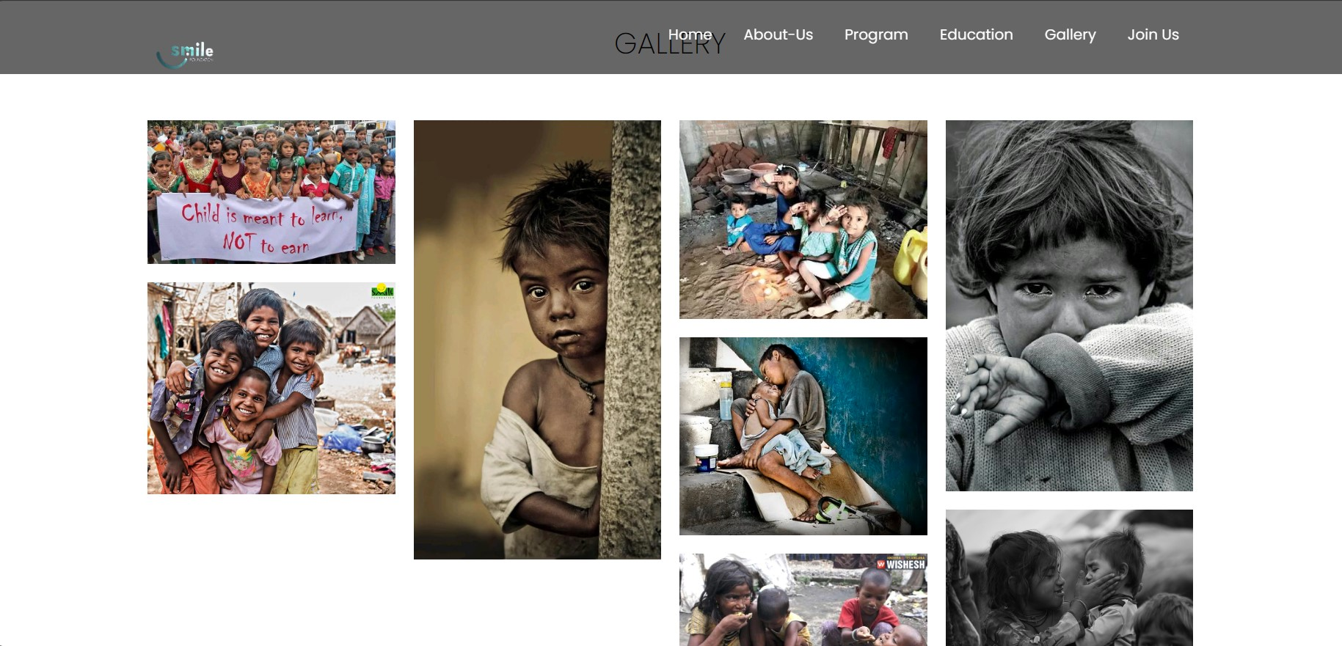
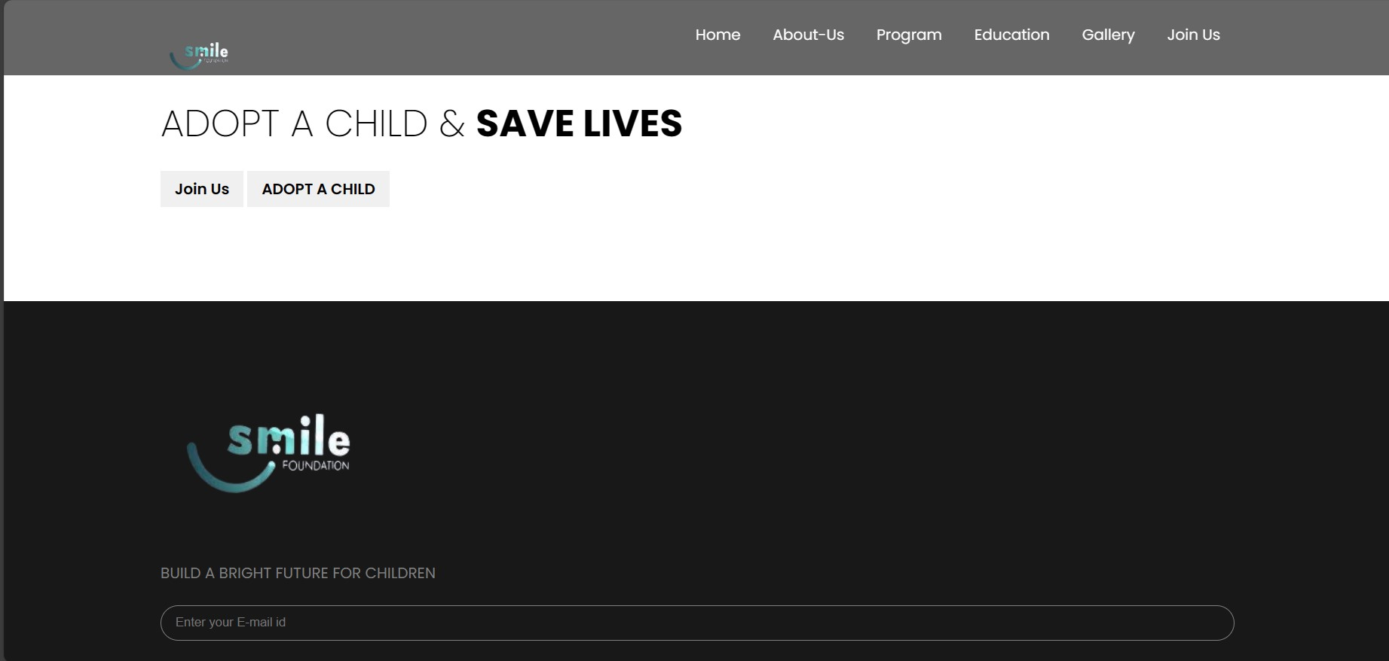

Slide 12


